Slide 1
Career Skills Program
Holloman AFB
Oversight for Program - Education Office
CSP Program Manager – Kimberly Lawhorn – 572-3971

Slide 2
Airman Requirements
Department of Defense Instruction 1322.29, Job Training, Education Skills
Training, Apprenticeships and Internships (JTEST-AI)
Transitioning Airmen within 180 days of separation
Participation is self –initiated and approved by the commander
JTEST-AI must offer a high probability of post-service employment with the provider or any employer and offer enrollment at no cost or minimal cost to the Service member.
Member will demonstrate understanding of employment prospects
Able to document 51% + probability of employment for planned the geographic location to which the member will relocate upon Date of Separation.
Airman must forward completed application to education office 30 days prior to program start date.

Slide 3
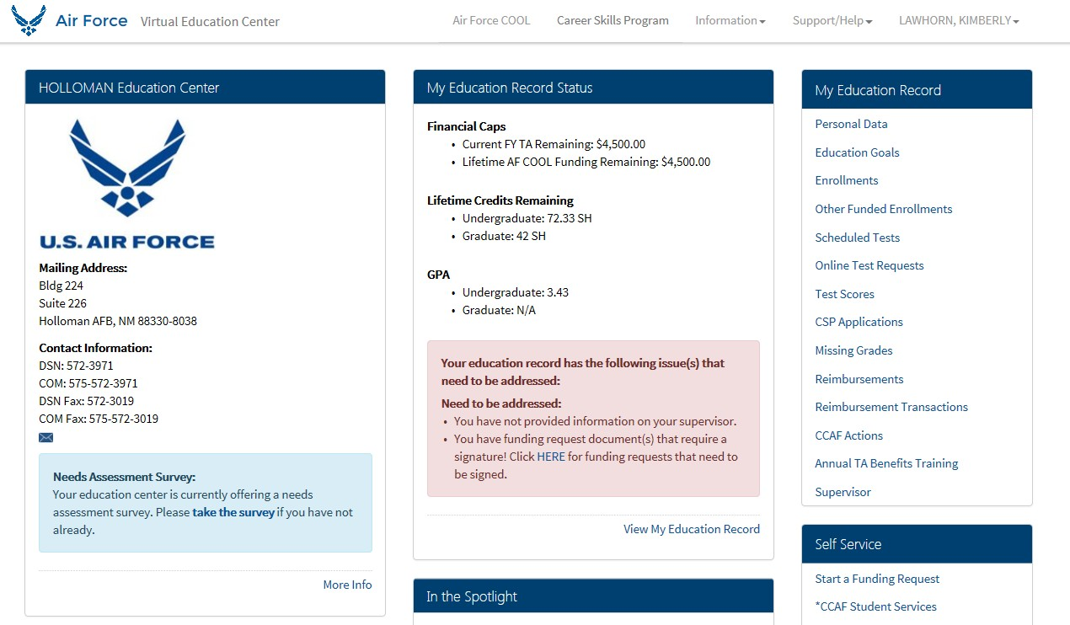
Airman Requirements (Cont’d)
Airman must sign Memorandum of Participation
Airman can only participate in one program
There is no limit for job shadowing
Automated process via AFVEC
Submit CSP Application thru AFVEC
Applications are approved by Ed office before the Unit CC
Sources of Training and Information
http://connect.dodskillbridge.com/ catalogs programs
College Internships, practicums and student teaching

Slide 4
Company/ Business Requirements
Programs that are training, pre-apprenticeship, or apprenticeship should
meet at least one of the following four criteria:
Approved by the U.S. Department of Veterans Affairs
Accredited by an agency recognized by the U.S. Department of Education
Certified program accredited by the American National Standards Institute (ANSI)
Be a registered apprenticeship program or a pre-apprenticeship training program offered by an industry-related organization meeting the standards for registered apprenticeship. These standards are administered by the U.S. Department of Labor’s Office of Apprenticeship

Slide 5
Responsibilities
E&TS Chief Responsibilities
Manages/executes program
Publishes program information
Reports program metrics to MAJCOM
Screens and approves CSP providers
Establishes MOU between installation and CSP providers
Unit/Squadron Commander Responsibilities
Approves Airman’s program participation for a single program
Appoints a designated unit representative to manage, track and report CSP participation
Airman Responsibilities
Airman may apply through self-nomination thru AFVEC

Slide 6
Types of CSPs
CSPs are vocational and technical training programs that focus on the practical application of learned skills, and can lead to employment in a specific career or technical trade
4 Types of CSPs are:
Apprenticeships
Internships
On-the-Job Training
Job Shadowing
Note: AF COOL is available for Credentialing

Slide 7
Apprenticeships
Apprenticeships – are generally a combination of OJT and related instruction that may by sponsored jointly by an employer and union groups, individual employers, or employer association
Apprenticeships must be registered with one of the following organizations:
The U.S. Department of Veterans Affairs (VA) approved as an “Education and Job Training Program.” See U.S. Department of Veterans Affairs “Search for Approved Education and Job Training Programs” web site – http://www.nasaa- vetseducation.com/

Slide 8
Apprenticeships (Cont’d)
The American National Standards Institute (ANSI) accredited as a certificate
program. See ANSI’s “Directory of Accredited Certificate Issuers,
Applicants, and Suspended Issuers” web site – http://tinyurl.com/In4r9jv , or
Recognized as accredited by an accrediting agency listed with the U.S. Department of Education. See U.S. Department of Education’s “Database of Accredited Programs and Institutions”
The U.S. Department of Labor (DOL) and/or a State Apprenticeship Agency in the state in which it operates – See U.S. DOL’s “List of State Apprenticeships Websites” – http://www.doleta.gov/oa/stateagencies.cfm

Slide 9
Internships
Internships – a type of work experience for entry level job-seekers.
Internships may be completed in federal, state, or local government, or
private sector.
Airmen are eligible for only one internship during their transition period
Examples of internships:
Legal intern | Communications intern | Engineering intern | Natural Resources intern
Finance/accounting intern | Veterinary intern | Computer Science intern | Mining intern
Manufacturing intern | Journalism intern | Radiological intern | Hotel services intern
Forestry intern | Nuclear energy intern | Business administration intern | Culinary intern

Slide 10
On-the-Job Training
OJT – job skills learned at a place of work while performing the actual job
OJT programs – must meet certain criteria (e.g., approved by the Veterans’ Administration , or recognized by an accrediting agency)
OJT training programs may also be accredited by the Council on Occupational
Education (COE)

Slide 11
Job Shadowing
Job Shadowing – is a type of OJT work experience that is normally performed in one day, where individuals learn about a job by observing the day-to-day activities of someone in the current workforce.
Types of Job shadowing may include
Restaurant employees – cooks, bartenders | Medical profession jobs – physical therapy occupational therapy, radiologists
Manufacturing jobs – machine operators, tool & die makers | Skilled trades jobs – carpenters, painters, electricians
Management jobs – supervisor, entrepreneur, business owner | Education jobs – instructor, teacher aid, or counselor
Radio or television jobs – journalist, broadcaster, technician | Law enforcement jobs – police officer, dispatcher, and detective

Slide 12
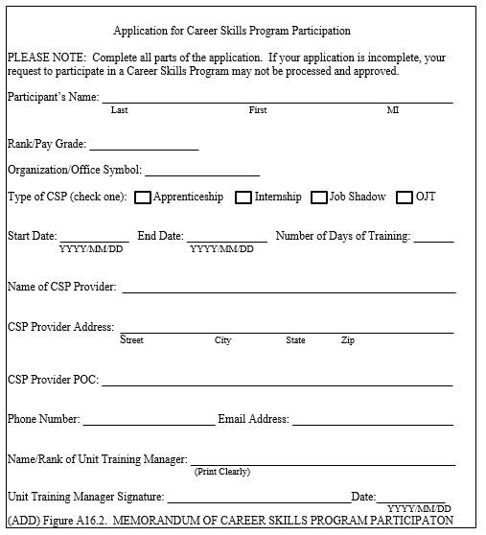
Sample forms
Application for CSP Participation

Slide 13
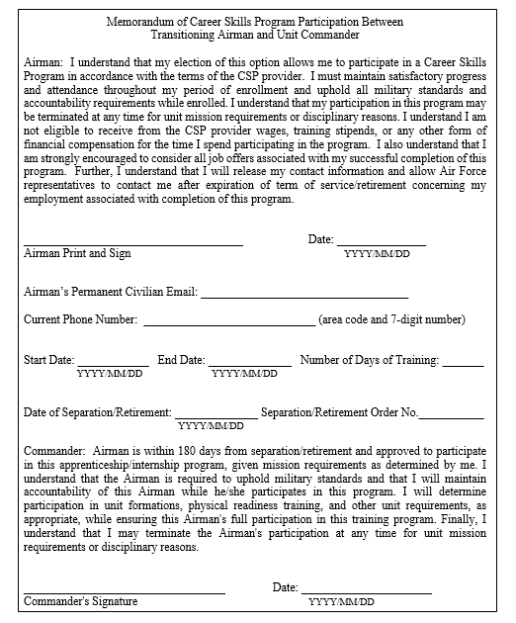
Sample Forms (Cont’d)
Memo for Participation

Slide 14
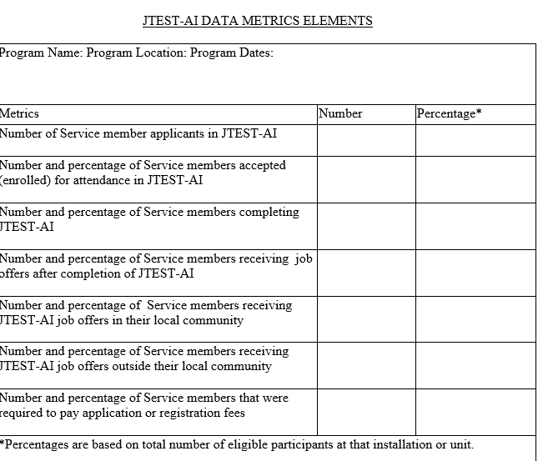
Sample Forms (Cont’d)
CSP Data Metrics Elements

Slide 15
Resources
http://connect.dodskillbridge.com/ catalogs programs
https://army.deps.mil/army/cmds/imcom_G3/cop/SitePages/SFL/2.aspx
DP2SST – MAJCOM Voluntary Education Managers
AF/A1DLT – Ms. Nanette Howard
AF Program Manager

Slide 16
Holloman Education Office
Kimberly Lawhorn
Career Skills Program (CSP) Manager
575-572-3971
49fss.fsme@us.af.mi

